Slide 1
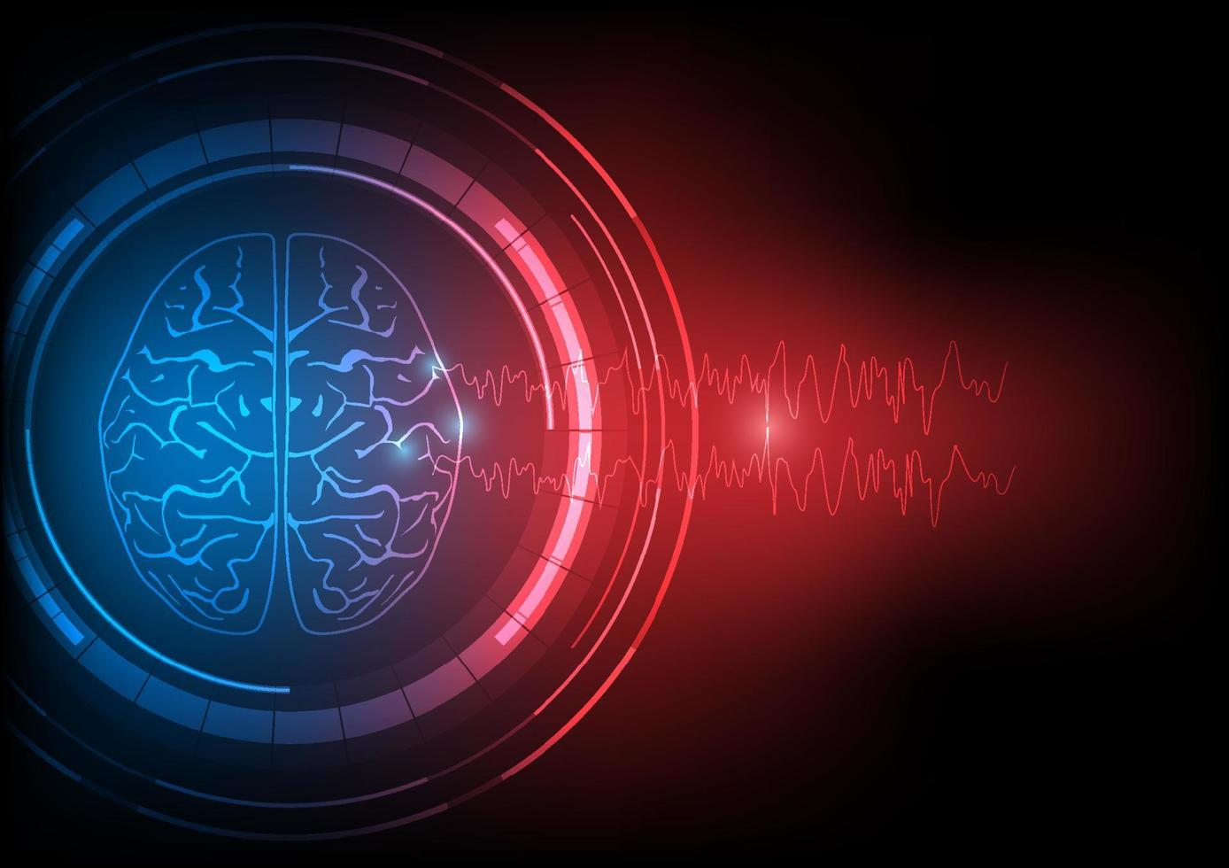
Brain Wave Classification from EEG Using Machine Learning and Deep Learning

Slide 2
COURSE: CSE499B
Group-07
Sumaiya Binte Sultana Fatema | Jubair Hossain
2021612642 | 2021626642

Slide 3
Understanding Brain Waves
EEG signals contain complex information about visual perception.
Traditional methods require manual feature extraction, limiting efficiency.
Deep learning, particularly CNNs, can automate feature learning for classification.

Slide 4
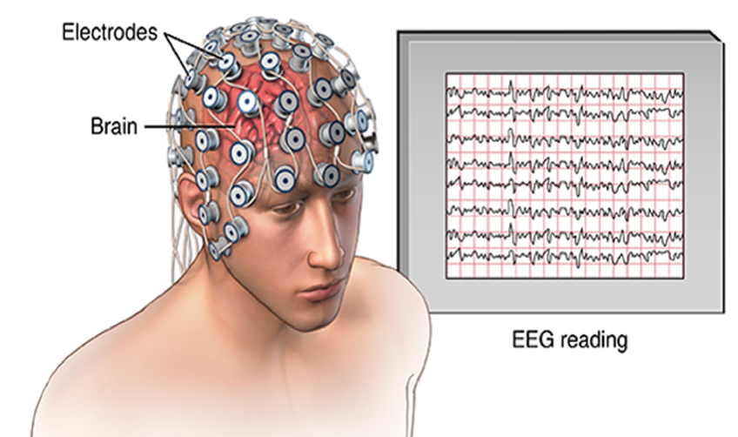
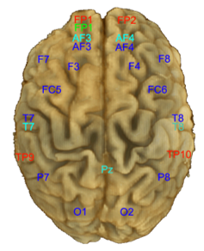
Understanding Brain Waves

Slide 5
THE Dataset
MindBigData (The “MNIST” of Brain Digits) is an open database containing 1,207,293 brain signals
Brain signals of 2s each, captured with the stimulus of seeing a digit (from 0 to 9) and thinking about it. The raw EEG signals were captured 128 Hz sampling rate, so there are approximately 256 (128 × 2 secs) data points for each stimulus image of digit 0–9
Sample: 65,000 (10,000 in 1st phase)
Training: 80%
Testing and Validation: 20% https://www.mindbigdata.com/

Slide 6
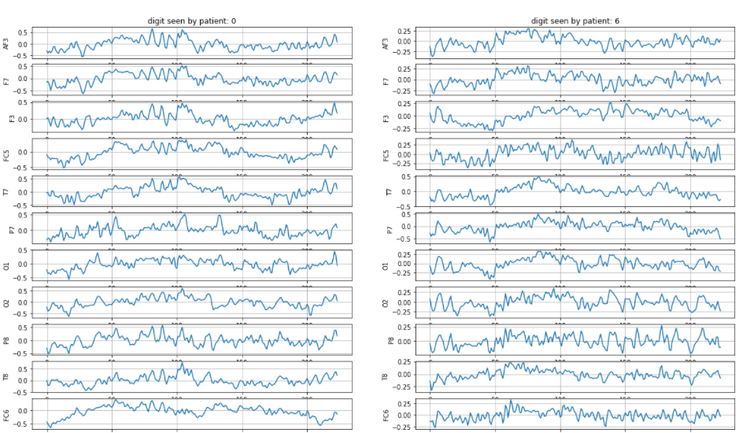
Dataset Sample

Slide 7
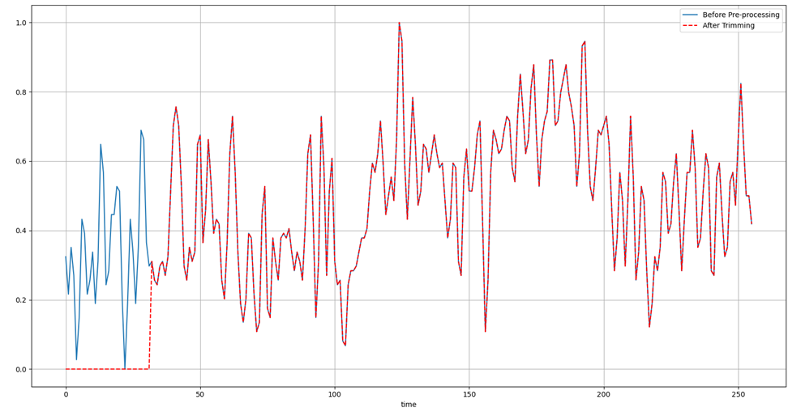
Preprocessing the Data
•Trimming 250ms of the begging of the signal, to avoid sensor power on noise.
•Scaling and Standardization of input data.

Slide 8
Literature Review – paper
01
Title: "A Deep Evolutionary Approach to Bioinspired Classifier Optimisation for Brain-Machine Interaction"
Description: The datasets for these experiments were collected using a Muse EEG headband (with electrodes placed at TP9, AF7, AF8, TP10) and the EEG MindBigData digits dataset (with electrodes at TP9, FP1, FP2, TP10).
Results and outcome:
Non-boosted DEvo MLP: 79.81% (attention), 96.11% (emotional), 27.07% (number-guessing)
Adaptive Boosted DEvo MLP: 31.35% (number-guessing)

Slide 9
Literature Review – paper
02
Title: "An Efficient Signal Processing Algorithm for Detecting Abnormalities in EEG Signal Using CNN"
Description: The study presents an efficient signal processing algorithm using a 1D Convolutional Neural Network (CNN) to detect abnormalities in EEG signals. The proposed deep learning model classifies EEG signals into normal, pre-ictal, and seizure categories without requiring manual feature extraction.
Results and outcome: Achieved 85.48% accuracy with a 14.5% error rate, outperforming traditional methods. Improved precision (76.65%), recall (78.2%), and F1-score (69.12%). CNN-based automatic detection method provides faster and more accurate EEG analysis, aiding in early diagnosis of neurological disorders.

Slide 10
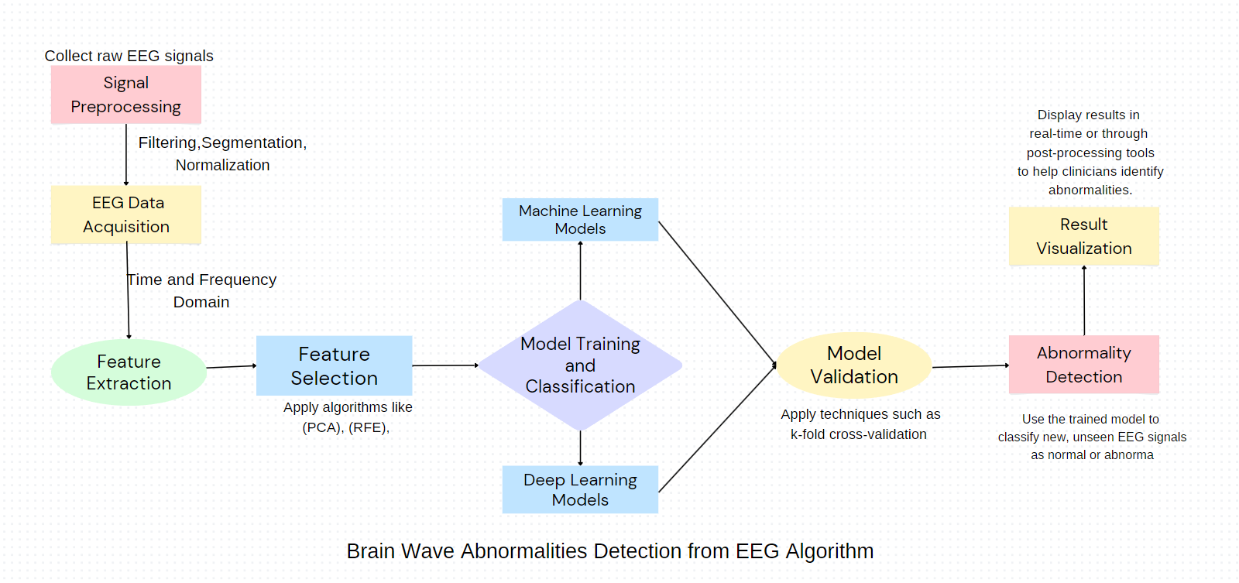
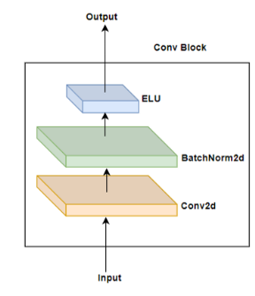
Work Process: Overview
Architecture of our CNN

Slide 11
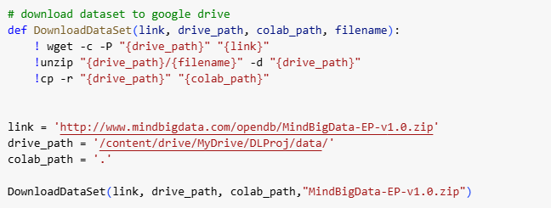
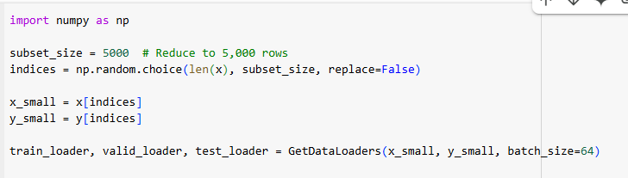
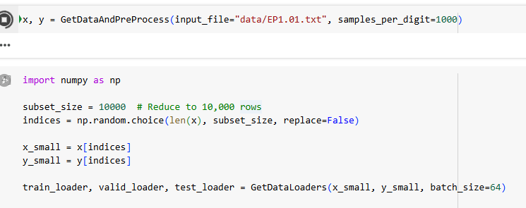
Work process: preprocessing and splitting
01

Slide 12
Ml models classification accuracy
Model Name | Accuracy
1️⃣ Logistic Regression | 10.4666%
2️⃣ Support Vector Machine (SVM) | 13.2666%
3️⃣ Random Forest | 11.4666%
4️⃣ K-Nearest Neighbors (KNN) | 10.1333%

Slide 13
Proposed Modules: CNN
Conv2dBlockELU is a custom convolutional block used in the CNN model.
It is a wrapper around nn.Conv2d, nn.BatchNorm2d, and nn.ELU()
The CNN consists of convolutional layers, dropout, and fully connected layers. Each layer extracts different levels of features, which are passed through non-linearity and normalization to improve learning.
🔹 Input Data: EEG signals with shape (batch_size, 14, 224) 🔹 Goal: Classify EEG signals into 10 categories
Primary training: with 10,000 data

Slide 14
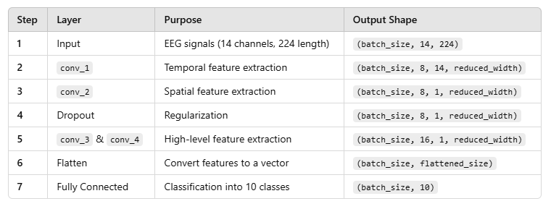
Planning: inside look at our CNN
01

Slide 15
Existing CNN models: Literature Review
Research | Methodology | Accuracy
Bird et al. [1] | LSTM | 27.0718%
Grover et al. [2] | GRU | 33.88%
Our proposed model: | CNN | Yet to do.

Slide 16
Challenges and Observations
Data imbalance in features.
Computational requirements for deep learning.
Noise in raw EEG data.

Slide 17
Referances
Bird, Jordan J., et al. "A deep evolutionary approach to bioinspired classifier optimisation for brain-machine interaction." Complexity 2019 (2019).
Jolly, Baani Leen Kaur, et al. "Universal EEG encoder for learning diverse intelligent tasks." 2019 IEEE Fifth International Conference on Multimedia Big Data (BigMM). IEEE, 2019.

